Slide 1

Programming and Data Visualization for Researchers
[PSY3035 / HEL-8048]
Workshop 5
James McCutcheon
IPS / Helsefak

Slide 2

Project management
Using good principles of project management will make your life easier (and other people’s)
It is absolutely essential once your projects start to get more complicated

Slide 3
Project management – folder structure
Starting with a consistent project structure for each separate project will help you to find things and keep items organised
main project folder
Files
README.md
.gitignore
environment.yml
data
docs
results
scripts
source
data, e.g.
.csv files
docs + help files
figures, e.g.
.pdf or .jpg
scripts and notebooks, e.g. .py and .ipynb
resuable python files (your own module!)

Slide 4
Project management – folder structure
Starting with a consistent project structure for each separate project will help you know how to find things
| -- data
| -- docs
| -- results
| -- scripts
| -- source
-- .gitignore
-- environment.yml
-- README.md
Some projects also contain a tests folder
Can use a cookiecutter to make a consistent project structure every time
Notes:
Also mention ‘tests’ and cookiecutter
But we will make our own

Slide 5

Version control
Also known as “source control” or “source code management”
Solves several problems that can emerge when working on a software project, for example…
Notes:
Also mention ‘tests’ and cookiecutter
But we will make our own

Slide 6
Version control
Keeping track of different versions of the same project
Multiple people working on same code
Fixing bugs and other issues efficiently
Notes:
Also mention ‘tests’ and cookiecutter
But we will make our own

Slide 7
Version control
We will use Git and Github (but there are other options)
How are these different?
Git is piece of software that lives on your computer and will keep track of the changes to a folder
Github is a website/company that allows you to sync the folders on your computer with the cloud
We will use both!
Notes:
Also mention ‘tests’ and cookiecutter
But we will make our own

Slide 8
Version control – some important terms
Repository
Just another word for a folder really. Each project you create will be in its own repository.
After making some changes to your code you commit them. You can think of each commit like a “save point”.
Commit
Push/pull
You push changes from your computer to the cloud and pull changes to get any updates from the cloud.
Branch
You can make changes on a branch of your repository before merging back together with the main branch.
Your computer is the local repository and the cloud version is the remote repository (or sometimes called origin)
Local vs remote
Notes:
Go through main terms then let’s go to Github Desktop and make our own repository

Slide 9
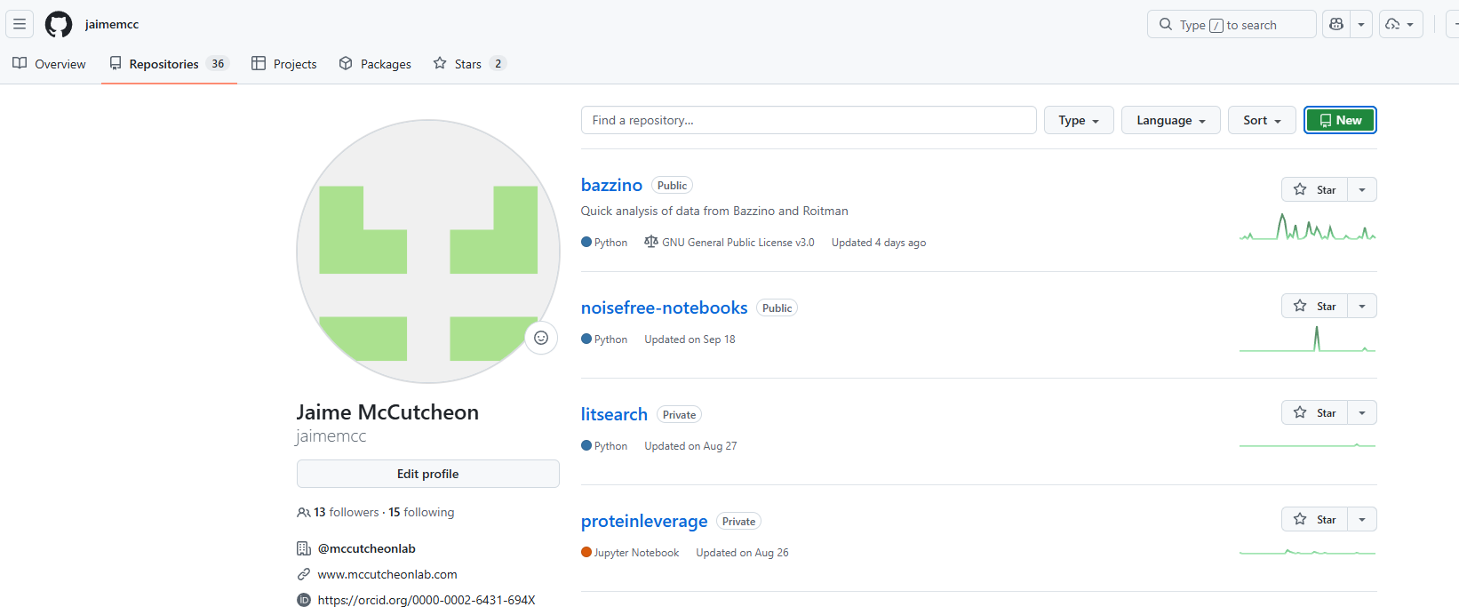



Slide 10
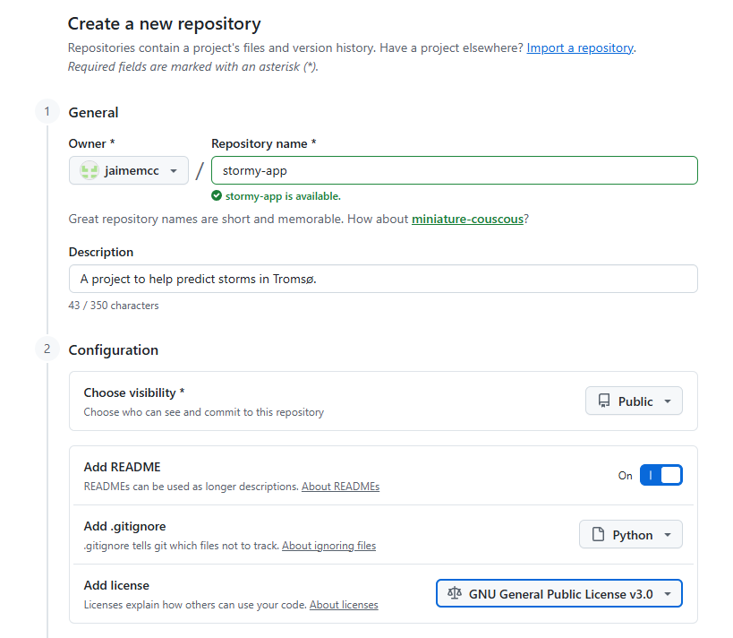

Slide 11
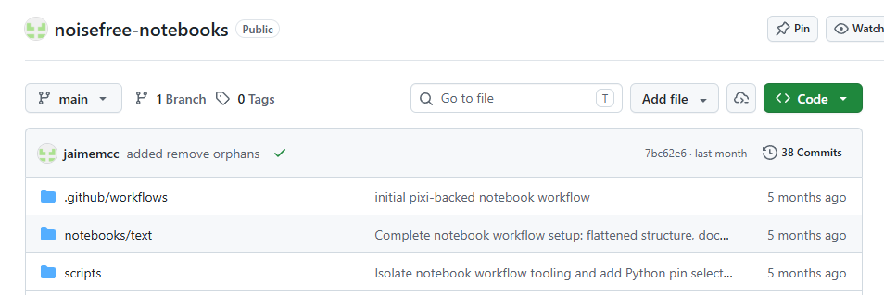


Slide 12
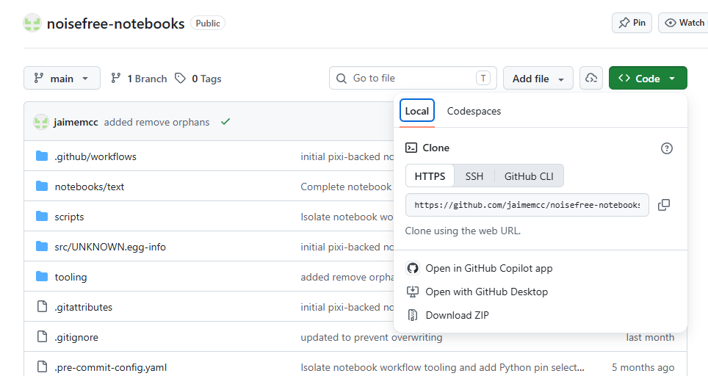


Slide 13
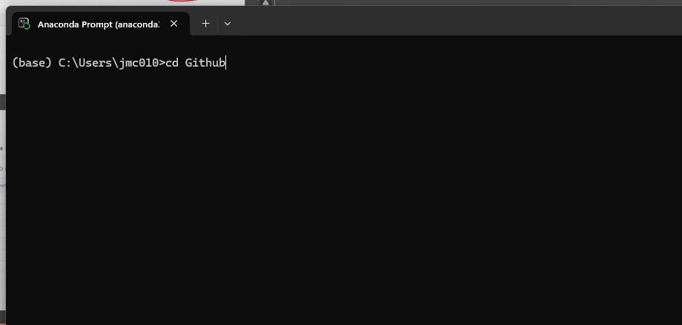

Slide 14
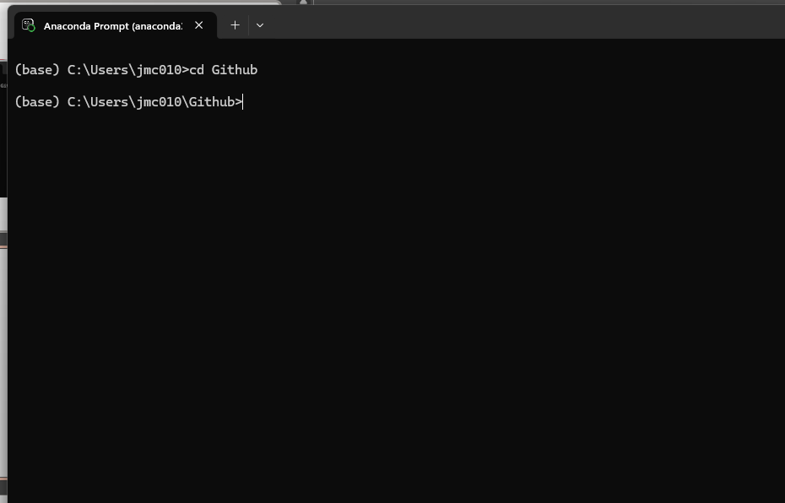

Slide 15
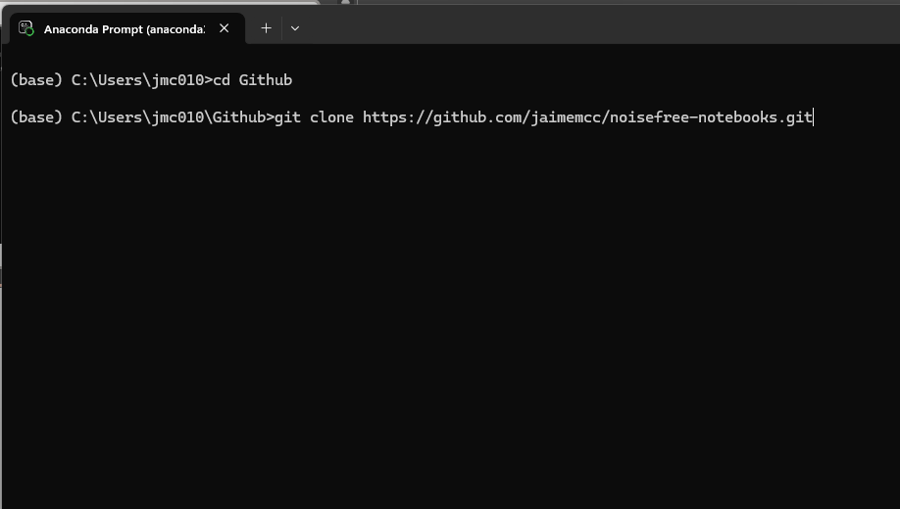

Slide 16
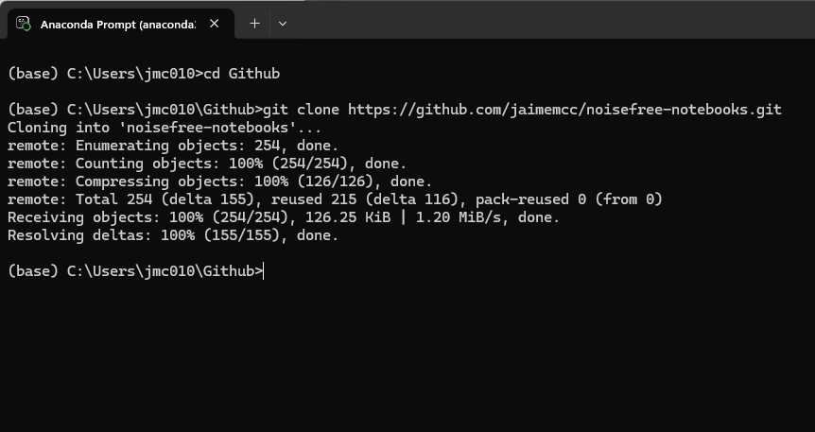

Slide 17
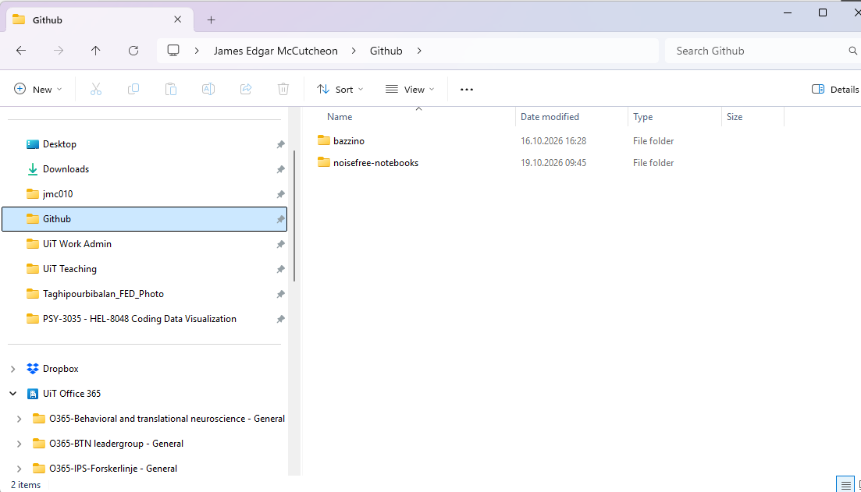


Slide 18
Making a folder structure
1. Go to your cloned folder using windows explorer (or can use VS Code)
2. Inside this project folder make the following folders…
| -- data
| -- docs
| -- results
| -- scripts
| -- source

Slide 19
Let’s make a quick edit to the README file…
Open the README file that was automatically created when you made the repository (can use VS Code or Notepad)
Add a line or two to it – doesn’t matter what exactly, maybe a little extra description of the project.
We will then commit this and push it to the online repository.

Slide 20

COFFEE TIME

Slide 21
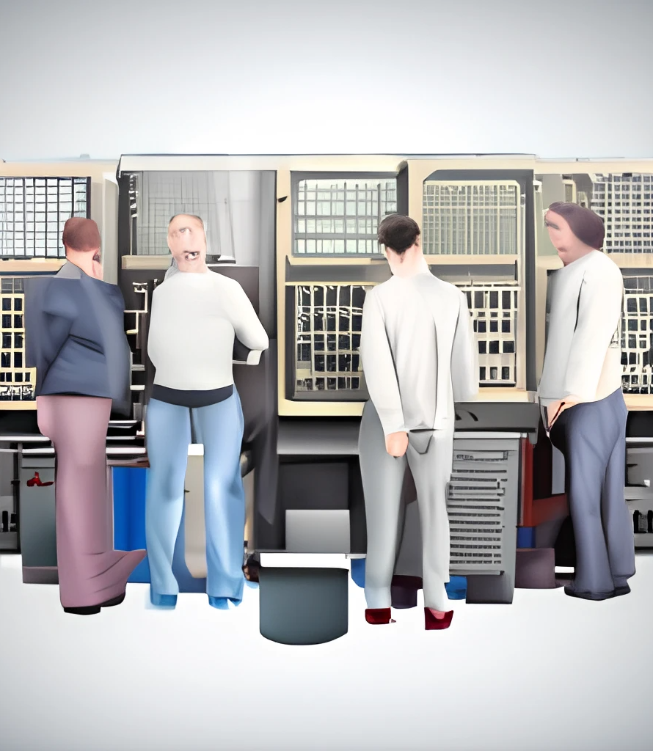
Why do I need a README file?
A README file lets people know important info about your project.
This includes how they can use the code, contribute to the project, and who should get credit.

Slide 22
What should a README contain?
Project title
Description
How to use your project
  Might include installation instructions if this is appropriate
Credits
License
However, there are no strict rules but following some of these conventions can help

Slide 23
Let’s write a README file
Go to https://readme.so/editor

